Slide 1
THE RIGHT TO LEAVE ANY COUNTRY: UTOPIAN AND DYSTOPIAN OBSERVATIONS
Presentation by Boldizsár Nagy at the International Human Rights Conference „Legacies, Limits, Futures” of the Károli Gáspár University
16 October 2026

Slide 2
What this talk focuses on and what it leaves – mostly – in the shadow
Focus
Marginal remarks only
The right to leave any country including one’s own
The historical change of this right’s role
The legal limits of the right
The waning force of this human right
The less discussed counter-tendencies of expanding zones of free movement
- Entry conditions
- Non-refoulement
- Externalisation
- Non-access to procedure
- Push backs, interception at sea

Slide 3
Common roots of human rights and refugee law: the inherent equality and dignity of human beings

Slide 4
Common roots of human rights and refugee law: the inherent equality and dignity of human beings
Human dignity: - the common denominator in philosophical and legal approaches
Every human being (life) is valuable in itself = ontological postulation
This inherent value must be recognized and respected by others = a requirement for human relationships
The state is for the people and not the other way around = the requirement of a limited state
McCrudden, ’Human Dignity and Judicial Interpretation of Human Rights’
EJIL, 2008, 679. old.
ICCPR
Preamble
… the recognition of the inherent dignity and of the equal and inalienable rights of all members of the human family is the foundation of freedom, justice and peace in the world…
… these rights derive from the inherent dignity of the human person…
Charter of Fundamental Rights (EU)
Article 1
Human dignity
Human dignity is inviolable. It must be respected and protected.
Kant: Man can only be an end, not a means to an end
Notes:
Groundwork of the Metaphysics of Morals (1785), he posited that one must "act in such a way that you treat humanity, whether in your own person or in the person of any other, never merely as a means to an end, but always at the same time as an end".^{[8]}

Slide 5
Citizenship as a feudal prerogative

Slide 6
Citizenship is the core problem
Hannah Arendt (the right to have rights) notwithstanding
Citizenship is a birthright lottery: "good" citizenship is just like feudal privilege. It is not determined by the merit/sin of the person concerned (Ayelet Sachar, Joseph Carens, Dimitry Kochenov)
Bounded communities, or so-called "nation-states", are based on the distinction between citizens and foreigners („aliens”).
According to the communitarians (David Miller) those who (luckily) belong to the community have the right to exclude "strangers”.
Notes:
Carens, Joseph: The Ethics of Immigration OUP, 2013
Kochenov D, Citizenship (MIT Press 2019)
Shachar A, The Birthright Lottery: Citizenship and Global Inequality (Cambridge: Harvard University Press, 2009).

Slide 7
Citizenship is the core problem
But the bounded communities have no natural unity (United Kingdom - Great Britain - Scotland? Yugoslavia – Serbia - Kosovo? Sudan – South Sudan?)
and
Their physical borders are not morally justifiable. There is no "ontological correspondence" between the group and the territory it claims in 2026. (In fact, who would be the "rightful holder" of Lviv, Strasbourg, Dacca, Ogaden or New Mexico?) (Ok, there are some exceptions)
Migration enacts „citizenship as aristocratic justice”(Dimitry Kochenov): those born to the appropriate citizenship and political system (the blood aristocrats) may leave any country including their own – the „serfs” are tied to their birthplace and if they try to resist their fate by migration then states of transit or destination arrest them and return if they can
Notes:
Carens, Joseph: The Ethics of Immigration OUP, 2013
Kochenov D, Citizenship (MIT Press 2019)
Shachar A, The Birthright Lottery: Citizenship and Global Inequality (Cambridge: Harvard University Press, 2009).

Slide 8
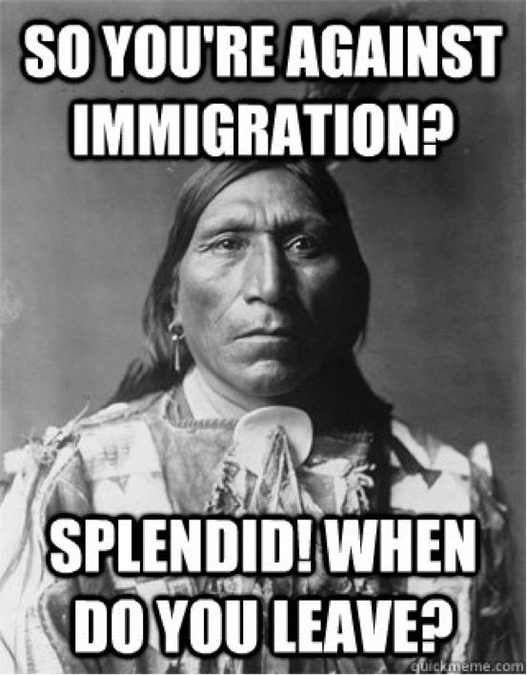
Whom does the land belong?

Slide 9
The content of the right to leave and its limits

Slide 10
Departure – a precondition to international protection
1951 Geneva Convention
The refugee (the asylum seeker) is „is outside the country of his nationality and is unable or, owing to such fear, is unwilling to avail himself of the protection of that country;
or who, not having a nationality and being outside the country of his former habitual residence as a result of such events, is unable or, owing to such fear, is unwilling to return to it.” (GC51, 1‚ A (2) §)
No general right to enter, but see Article 31 - impunity for irregular entry or stay
„1. The Contracting States shall not impose penalties, on account of their illegal entry or presence, on refugees who, coming directly from a territory where their life or freedom was threatened in the sense of article 1, enter or are present in their territory without authorization, provided they present themselves without delay to the authorities and show good cause for their illegal entry or presence.”

Slide 11
The role of 12 § (2) / P 4 2 § (2)
Unpacking the right of leaving any country – a crucial step in reaching asylum.
The content of the right
Crossing an international border is a right
Lawful stay is not a precondition, irregularly staying also have the right
The person is entitled to choose where to go
Travel document must be issued by the state of origin (and the transit?)
The lack of access to a travel document does not affect the claim to exercise the right (the right does not derive from the possession of a travel document)
Even if there is no evidence of admission to another country, the right to leave is applicable
_________________________
It is a right. States may not require to use it.
Expulsion has its own preconditions
Notes:
Other sources for the freedom of movement: E.g., American Convention on Human Rights 1969, 1144 UNTS 143, Art. 22; African Charter of Human and Peoples’ Rights 1981, 1520 UNTS 217, Art. 12(2); Arab Charter on Human Rights 2004, reprinted in 12 International Human Rights Report 893 (2005), Art. 27; Convention on the Elimination of All Forms of Discrimination against Racial Discrimination 1965, 660 UNTS 195, Art. 5; International Convention on the Suppression and Punishment of the Crime of Apartheid, 1973, 1015 UNTS 243, Art. II(c); Convention on the Rights of the Child 1989, 1577 UNTS 3, Art. 10(2). (From Markard, p. 594

Slide 12
Permitted limitation on the right to leave
ICPPR 12 (3)
Restrictions
* must be provided by law,
* necessary
national security
public order (ordre public),
*to public health
protect morals
rights and freedoms of others.
* Proportional
* No ad hoc decision by border guards or orders in unpublished circular
* Convenience, efficiency, diplomatic praise and economic reward do not justify Only proportional measure qualify as necessary. No viable alternative exists
* Nat. security, public order, public health – to be interpreted very narrowly: individual, direct threat has to be shown, or the person has to be a fugitive from justice
Morals and rights of others in the country probably unaffected by a departure (unless family type relations /custody of child etc./)
* The least restrictive means are proportional

Slide 13
Permitted limitation on the right to leave
ICPPR 12 (3)
Limits to restrictions
Consistency with the other rights recognised
Narrowly interpreted.
Must not impair the essence of the right (General Comment No. 27)
The relationship of the norm to the exception must not be reversed. (ibid)
The principle of proportionality must be respected not only in the law but also in the administrative practices (Ibid)
Restrictions must be consistent the fundamental principles of equality and non-discrimination.

Slide 14
The waning force of the right

Slide 15
Emerging practice: contactless control
Contactless control = „ the emergence of a novel variant of the ‘deterrence paradigm’ dominating for the last 30 years, characterised by a return to strategies of outright containment—as witnessed after the Cold War years during the genocidarian conflicts in Rwanda and Yugoslavia —but with a ‘deputational twist’, consisting in the inducement by countries of destination of countries of transit, so that the latter exert the necessary control in the former’s stead and/or for their benefit.” Moreno-Lax – Giuffré, p. 84.
ECtHR indirectly refused those ideas in S.S. and Others against Italy, Application no. 21660/18, Judgment 12 June 2025
para 80:
„In accordance with this case-law, where an allegation of extraterritorial jurisdiction is made, the Court will assess whether there are exceptional circumstances justifying a finding by it that the State concerned was exercising jurisdiction extraterritorially by reference to the specific facts of the case. The two main criteria are effective control by the State over an area (spatial concept of jurisdiction, or jurisdiction ratione loci) and State agent authority and control over individuals (personal concept of jurisdiction, or jurisdiction ratione personae).”

Slide 16
Aiding and abetting (assisting)
Is the EU responsible for what Lybian authorities (or Turkish authorities) do?
See: Moreno-Lax, Den Heijer, Molnár
„a sort of a ‚plausible likelihood’ that the aid or
support will be unlawfully utilised is the trigger which
will activate this form of derived or indirect responsibility within
the meaning of art. 16 ARSIWA. Against this backdrop, extraterritorial border management activities, such as training, funding and capacity building in third countries, could potentially fall under the scope of art. 16 ARSIWA if three requirements are fulfilled:
  1) the relevant state organ providing aid/assistance must have knowledge of the cir-cumstances making the conduct of the assisted State internationally wrongful;
  2) aid/assistance must be provided to facilitate that conduct which must indeed result in a wrongful act; and
  3) conduct must be such that it would have been wrongful even if it had been committed by the assisting State itself (‚a State cannot do by another what it cannot do by itself’ as the ILC put it in its Commentaries to ARSIWA, also known as the requirement of ‚opposability’”. (Molnár, 1025-26)
ILC ARSIWA, 2001
Article 16
Aid or assistance in the commission of an internationally wrongful act
A State which aids or assists another State in the commission of an internationally wrongful act by the latter is internationally responsible for doing so if:
(a) that State does so with knowledge of the circumstances of the internationally wrongful act; and
(b) the act would be internationally wrongful if committed by that State.
Notes:
EU countries making the neighbouring third countries do the “dirty job” by using them as “proxies” in certain border management activities might avoid the jurisdiction of the Euro-pean Court of Human Rights (ECtHR) within the meaning of art. 1 of the European Conven-tion on Human Rights (ECHR).15 – is typ-ically not contested, as it is clear in virtually all instances that officials of State organs have been involved in the allegedly wrongful conduct.16 14 In such cases of eventual human rights violations, attribu-tion of a wrongful conduct to a State – which needs to be sharply distinguished from “juris-diction” under art. 1 ECHR, although the ECtHR tends to mix up the two concepts(molnár, 2023, at 1017

Slide 17
The recreation of the hierarchy among states
The developed resourceful dominant state
The dominated, service providing (exploited) state
Committed to refugee protection
Reluctant to perform
Serves the priorities („interests”) of the resourceful, dominant state
Domestic deterrence
Restrictive interpretation
Dire reception conditions
Cumbersome, long procedures
Lack of assistance to recognised refugees
Evasion
The dominated state becomes the tool of the dominant state, it breaches 12 (2) for another state’s sake
Responsibility shifting
Safe third country rules
Intra regional allocation „Dublin”, AMMR solidarity
- Intercepts and pulls back those in transit towards the dominant state.
- Establishes processing centers for asylum seekers transferred from the dominant state.
- Opens return hubs for irregular migrants, returned from dom. st.

Slide 18
Counter-tendencies:
Zones of free movement

Slide 19
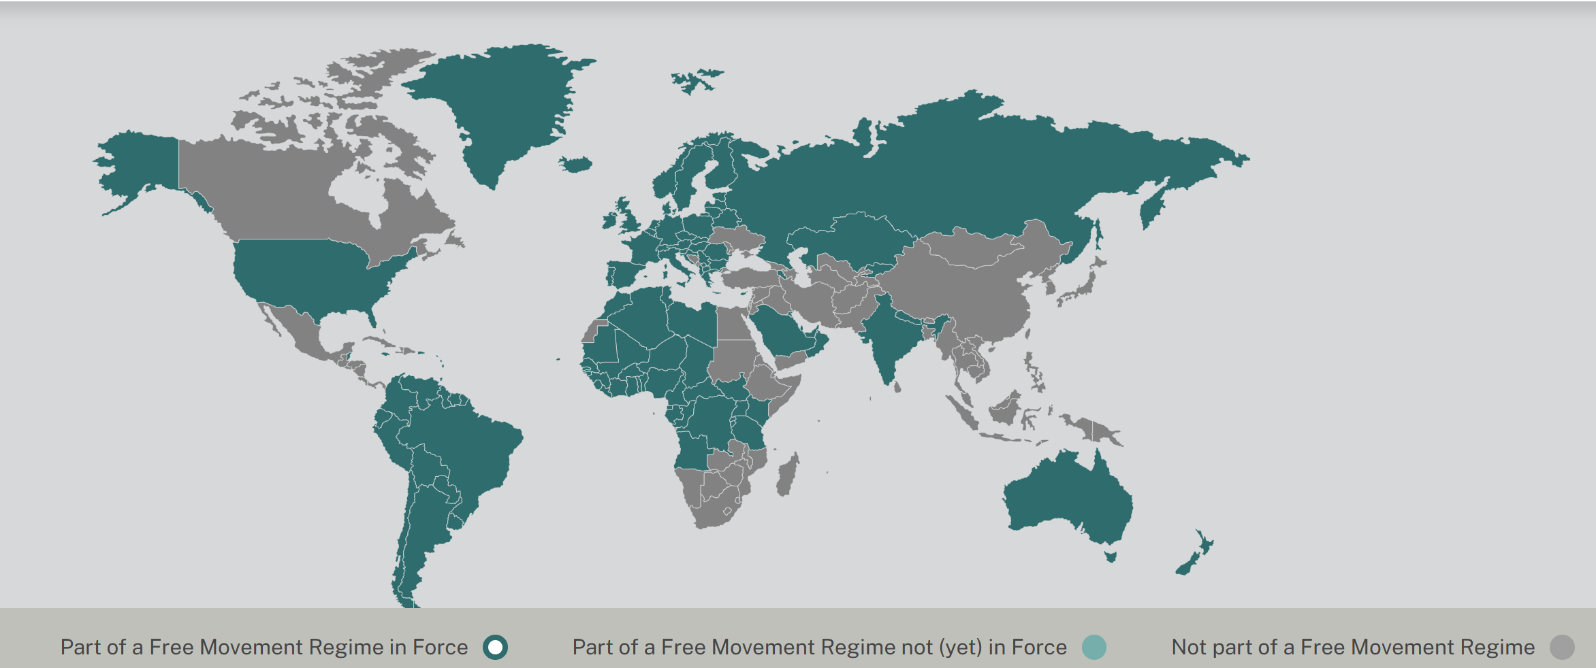
(Not so) utopian observations
Free movement across borders
Source: Diego Acosta and Luuk van der Baaren (2024), Freemove Project, Free Movement Regimes Dataset: Indicators on entry, residence, rights, and security of residence, www.freemovehub.com

Slide 20
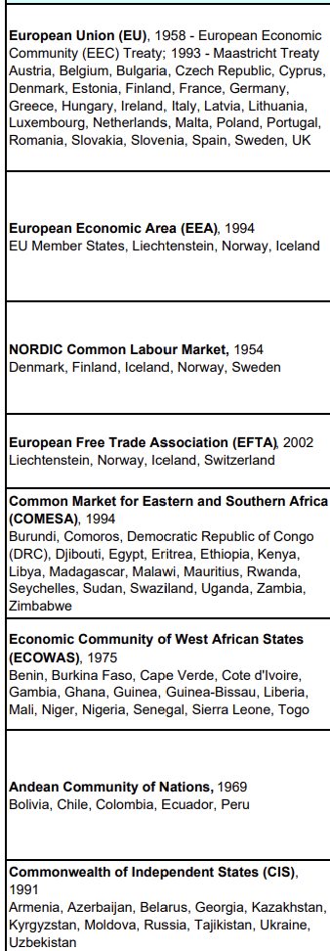
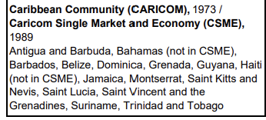
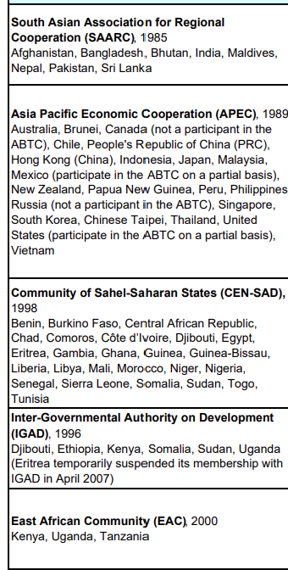
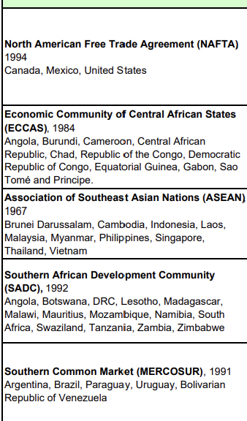
Regional organisations offering more or less freedom of movement and settlement in 2010
Full mobility of labour
Certain groups /Gats 4/
Facilitated entry
Source: IOM
Overview: Liberalized Movement of Persons in Regional Integration Agreements
https://www.iom.int/sites/g/files/tmzbdl2616/files/2018-09/Annex%20Overview%20-%20Liberalized%20movement%20of%20persons%20in%20regional%20integration%20agreements.pdf

Slide 21
One example - Andean Community (CAN)
Established in 1969
Members: Bolivia, Colombia, Ecuador, Peru.
Decision 878 Andean Migratory Statute, Lima, 12 May 2021. It entered into force on 11 August 2021
„WHEREAS: The free movement and establishment of people constitutes a central objective in strengthening the Andean community space and one of the visible elements that help reinforce the sense of belonging of the community citizen with the integration process;…”
Rights:
- enter with ID
- temporary residence: 2 years
- permanent residence after 2 years
- right to work and establishment (self employed and , business
venture)
- equal treatment with nationals

Slide 22
Waving the themes together

Slide 23
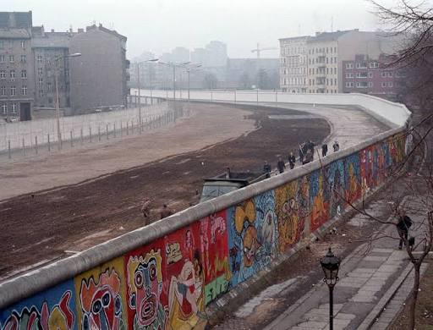
The right to leave and its enemies
Changing patterns of disregard
Cold War
- locking in the whole population
- temporary exit is privilege and reward
(GDR, Romania, North Korea, Cuba)
- denial of exit as a form of collective punishment of the family a member of which did not return from abroad
- prevention of emigration by not allowing the whole family to travel together, forcing some members to stay put
Cultural/religious reasons
- women not allowed to travel without male companion or at least their permit (Yemen, earlier Saudi Arabia, Afghanistan)

Slide 24
The right to leave and its enemies
Changing patterns of disregard
Contemporary obstacles
- Affluent states externalise their border controls, by using transit states as tools – contactless control. At the price of making the transit states breach the right to leave they free themselves of the duty to assess asylum claims and of returning people who have no right to stay. Pullbacks

Slide 25
Dystopian and Utopian changes – two full circles
Until World War I
Free movement and settlement for the non-land tied
1918 –
Passports, visas: limited mobility. Exit controls by authoritarians
Pull back,
Denial of exit from state of origin or transit
Increasing number of free movement and settlement areas and regions
Feudalism – aristocracy – serfs
Hierarchy
Citizenship – to eliminate aristocratic privileges - equality
Citizenship -blood aristocracy again
Hierarchy
(of states)
= Dystopian direction
= Utopian diretion

Slide 26
Summary
The right to leave
Is an essential expression of dignity and the derived personal liberty and self determination.
- „As a precondition for the right to seek asylum, the right to leave thus complements the principle of non-refoulement; together, they form the basis of refugee protection” Markard, (2016), 596

Slide 27
Literary hints
Guild, Elspeth (2013) The right to leave a country_CoE issue paper
Heijer, M. den. (2011, April 7). Europe and extraterritorial asylum. Meijers-reeks. Retrieved from https://hdl.handle.net/1887/16699
Kochenov, D (2012) The Right to Leave Any Country Including Your Own in International Law 28 Connecticut Journal of International Law 2012, pp. 43-71
Kochenov, D V (2026). Citizenship as aristocratic justice. Brown Journal of World Affairs, 32(2), 155–169. https://bjwa.brown.edu/32-2/citizenship-as-aristocratic-justice/
Markard N (2016) The right to leave by sea: legal limits on EU migration control by third countries. European Journal of International Law, 27:591–616
McCrudden, (2008) ’Human Dignity and Judicial Interpretation of Human Rights’ European Journal of International Law, 655 – 724
Molnár, T (2023) EU Member States’ Responsibility Under International Law for Breaching Human Rights When Cooperating with Third Countries on Migration: Grey Zones of Law in Selected Scenarios European papers, Vol. 8, 2023, No 2, pp. 1013-1035ISSN 2499-8249 - doi: 10.15166/2499-8249/69
Moreno-Lax, V. & Giuffré, M, (2019) ’The Rise of Consensual Containment: From “Contactless Control” to “Contactless Responsibility” for Migratory Flows’, in Research Handbook on International Refugee Law 81 (Satvinder S. Juss ed)
Moreno-Lax V, (2020) ‘The Architecture of Functional Jurisdiction: Unpacking Contactless Control – On Public Powers, S.S. and Others v. Italy, and the “Operational Model”’ 21 German Law Journal 385 https://doi.org/10.1017/glj.2020.25
Stoyanova, V (2020) The right to leave any country and the interplay between jurisdiction and proportionality in human rights law. International Journal of Refugee Law 32:403–439

Slide 28
Thanks for your attention!
www.nagyboldizsar.hu

