Slide 1
INVESTMENT, MIGRATION, CORRUPTION Why should your grandfather’s blood buy you citizenship or residence rather than your 250 000 Euros?
Presentation by Boldizsár Nagy at the Center for Migration and Refugee Law,
Charles University, Prague,
8 December 2025

Slide 2
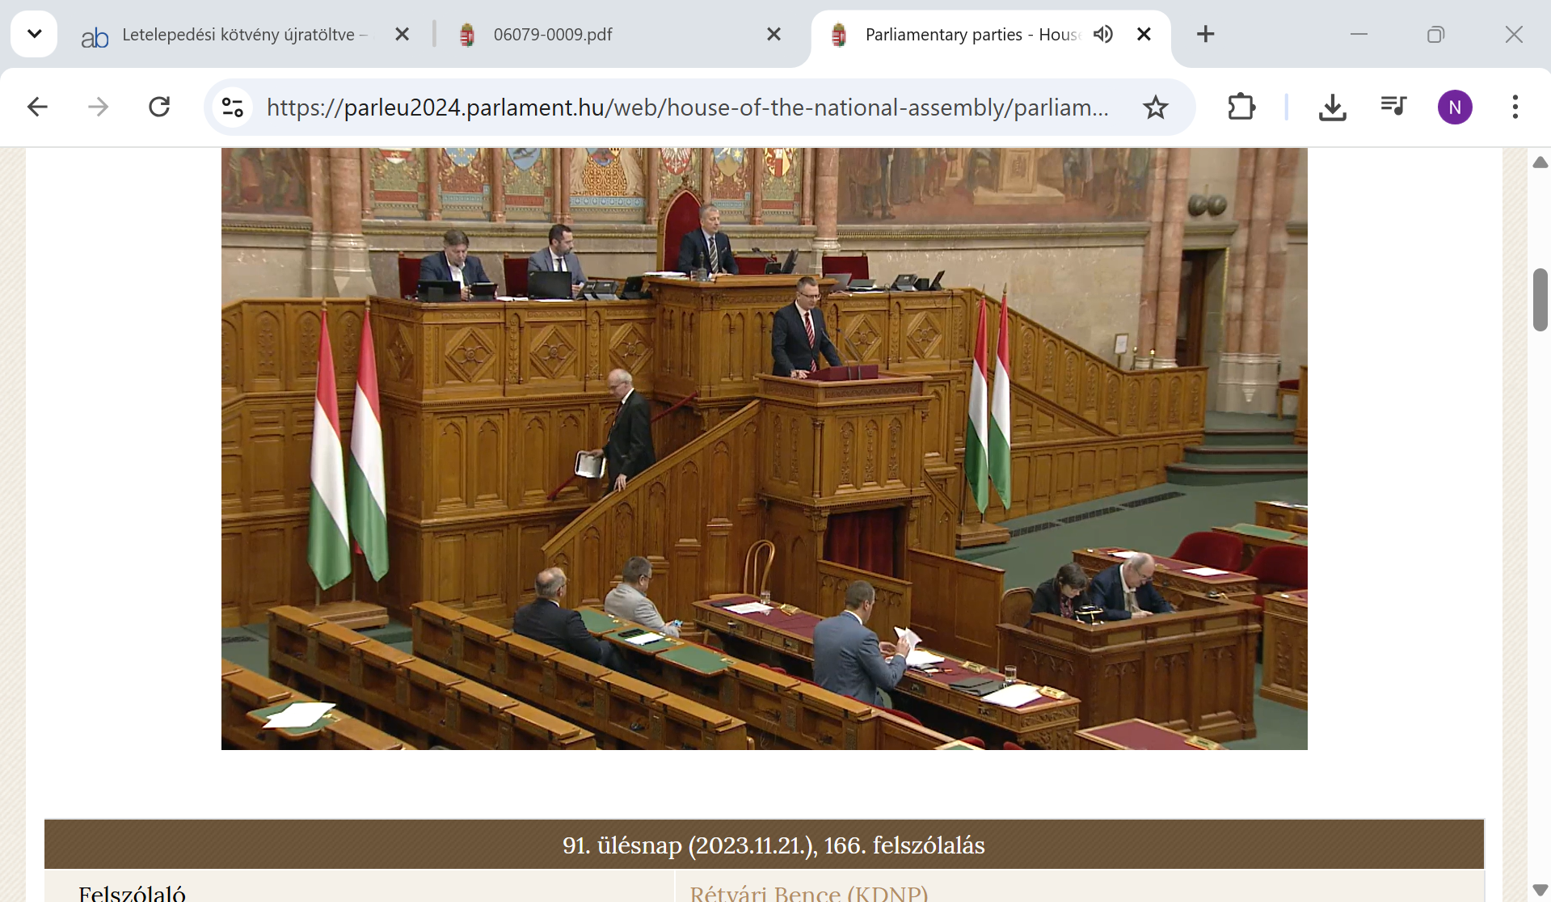
State Secretary Rétvári introducing the bill regulating the entry and stay of third country nationals, that created the „guest investor” status, at the beginning of the debate of the bill in Parliament, 21 November 2023: Hungary will never become an immigration country. Hungary belongs to the Hungarians. Here there will be neither migrantghettos nor migrantworkers (sic – BN)” https://bit.ly/44A4Ta3 (20251125)
Video:
https://sgis.parlament.hu/archive/playseq.php?date1=20231121&time1=084422&offset1=102214.172&date2=20231121&time2=084422&offset2=103918.163&type=real Click on the arrow!
Notes:
Magyarország soha nem lesz bevándorlóország, Magyarország a magyaroké, itt nem lesznek sem migránsgettók, sem migránsmunkások.
91. ülésnap (2023.11.21.), 166. felszólalás Felszólaló Rétvári Bence (KDNP) Beosztás Belügyminisztérium államtitkára Bizottsági előadó Felszólalás oka előterjesztő nyitóbeszéde Videó/Felszólalás ideje17:04

Slide 3

CONCEPTS, PREVALENCE

Slide 4
The concepts
Citizenship by investment (CBI) = performing predetermined payment or investment in a state leads to the grant of citizenship of that state, usually in a fast procedure = „Golden passport”
Residence by investmenent (RBI) ) = performing predetermined payment or investment in a state leads to a temporary (but reneweable) residence status (without naturalisation) which may lead to the right of permanent residence, usually in a fast procedure = „Golden visa”
Both are „transactional” making citizenship / right to live within a community a commodity
Mostly these are passive investments and/or mere payments to the budget
Notes:
Lucia Bocková, 2023:
„In the literature, authors use their own definitions of investment migration programmes. According to Džankić (2018), “immigrant investor programmes are policies developed by countries seeking to attract the wealthy to become their residents or citizens”. Sumption (2021, p. 4) defines these investment schemes as “policies in which the government awards a residence status or citizenship to individuals and/or their family membersin return for a financial transaction, with relatively limited requirements to be actively involved in the day-today operations of a business”. European Parliament Research Service study explains that CBI and RBI programmes are “formalised procedures that allow third-country nationals to obtain residence or citizenship in a host country in exchange for a passive financial contribution that may include government bonds, real estate,or bank deposits”. In addition, the study identifies the central elements of the investment migration programmes which should include: “primarilyfinancial conditions that require passive capital investments; minimal to no physical presence requirements; and/or fast track to residency orcitizenship in the country compared to traditional channels” (Fernandes, Navarra, De Groot, and Muñoz, 2021, pp. 1-43). OECD (2019, p. 2) clarifiesthat RBI and CBI schemes “allow foreign individuals to obtain residence rights or citizenship through investment or against a flat fee” and that they“are directed at passive investors, rather than entrepreneurs or investors who will be actively involved in operating a business they have created orin which they have invested as a sole proprietor or as a partner”. Transparency International and Global Witness (2018, p. 8) explain that “investment migration schemes offer fast-track citizenship and residency to foreign nationals in exchange for their substantial investment in thecountry“.

Slide 5
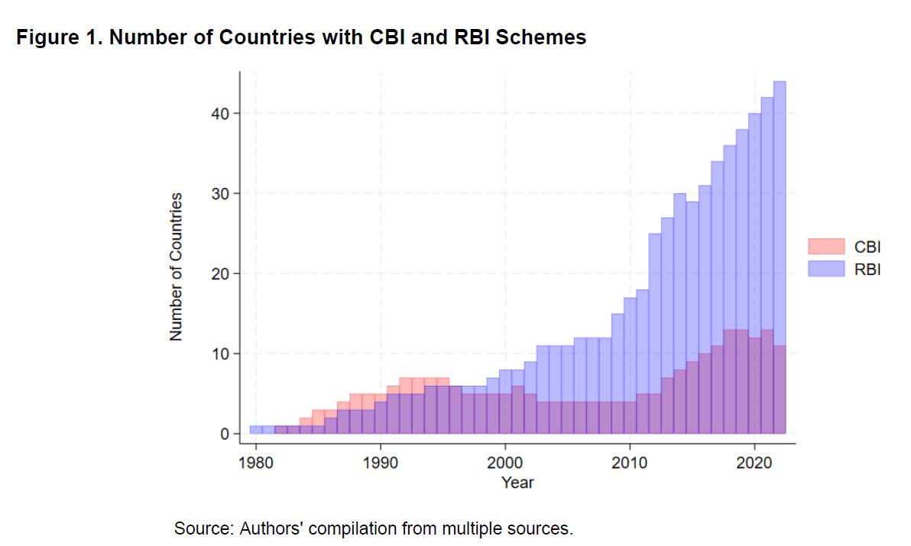
RBI PROGRAMS ARE ON THE GROWTH CBI’S MAY DECLINE
Source: Clerides et alii (IMF), p.3

Slide 6
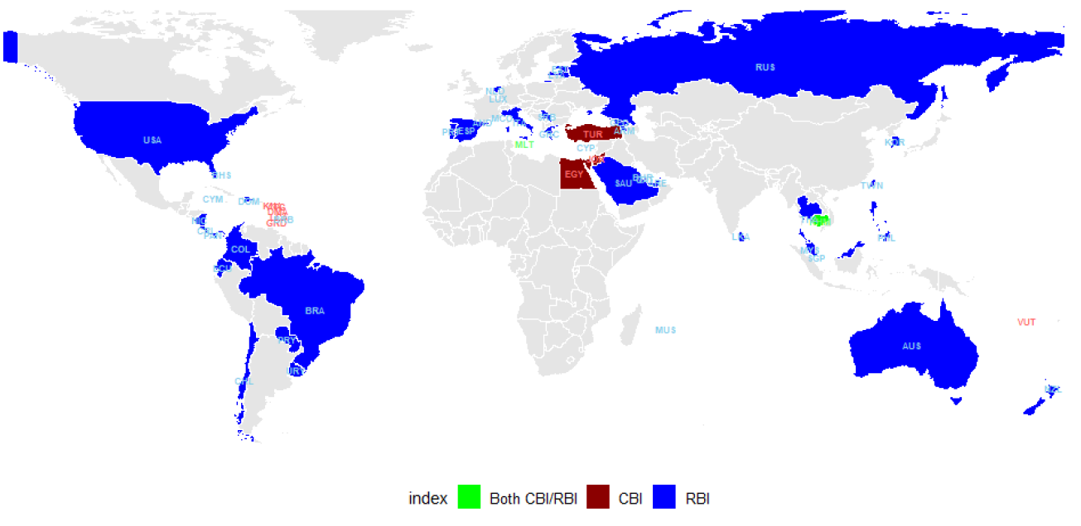
THE EXTENT OF CBI/RBI PROGRAMS IN 2022
In 2022
11 countries offered CBI
44 countries offered RBI
For a comprehensive, up-to-date
dynamic website on CBI and RBI check out:
https://www.imidaily.com/imi-program-pages/ (20251204)
Source: Clerides et alii (IMF), p.3
Notes:
„CBIs and RBIs have been around since the 1980s but have increased in popularity during the last decade. Figure 1 shows the number of countries that have offered such a scheme every year since 1980. Perhaps not surprisingly, given the nature of the programs, more countries offer RBIs than CBIs. Twenty-three countries have offered a CBI program at one time or another, with 11 programs being active in 2022. Many more countries offered an RBI program: 44 in 2022, up from about a dozen in the 2000s”

Slide 7
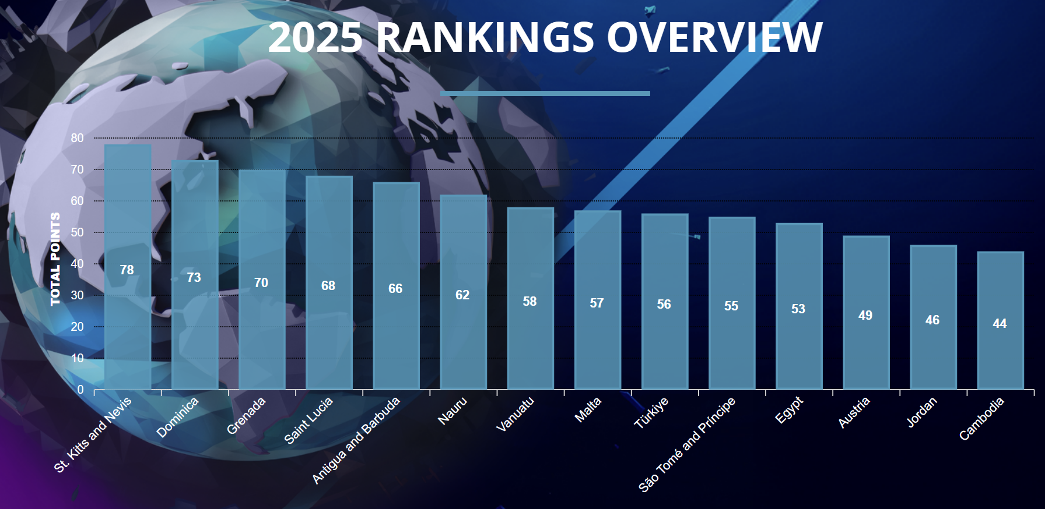
Competing CBIs – One Possible Ranking
James McKey CBI report 2025
www.cbiindex.com (20251204)

Slide 8
RESIDENCY/CITIZENSHIP BY INVESTMENT OVERALL REQUIREMENTS OF A WELL-FUNCTIONING PROGRAM
Contributes to the local economy
Job creation,
Real estate development in the non-profitable sector, e.g. national monuments
Additional source of the budget serving community purposes as a separate fund or trust
The process must be transparent, conditions non-discriminative and clear
Capable of avoiding money laundering

Slide 9
THE INVESTOR’S INTEREST
Bona fidei
Physical/political security
Backup escape route „insurance”
Future for kids
Freedom of movement
Enhanced economic opportunities
Instrumental (mala fidei)
Tax evasion (including inheritance tax)
Avoidance of financial scrutiny
Money laundering
Change of identity (identity laundering)
Shielding assets
Avoidance of capture/criminal prosecution

Slide 10

CORRUPTION RISKS
Corrupt system
The structure itslef benefits
- politically exposed persons
- privileged cronies
frequently through their intermediary companies having monopoly or unfair advantage in selection
- certain sectors, lobbying for RBI/CBI
Corrupt individual (acting against the rules of the system)
Police officials, bank clerks, due dilligence experts
Applicants, bribing the corrupt agent of the state
Notes:
On 23 February 2021, Vince Muscat, known as il-Koħħu, was sentenced to 15 years in prison after pleading guilty to the murder of Daphne Caruana Galizia.^{[90]} In his testimony, Muscat claimed that Alfred Degiorgio, who is also charged of executing the car bomb, received information from former Minister Chris Cardona on Caruana Galizia's whereabouts prior to her assassination, and subsequent tip-offs prior to the December 2017 arrests.^{[91]} Cardona dismissed these allegations as 'pure evil fiction'.^{[92]}
An inquiry by former judges "accused the Maltese state of creating a pervasive 'atmosphere of impunity' that allowed her killers to believe they'd face minimal consequences".^{[93]}
In July 2022, Alfred Degiorgio's brother George Degiorgio, speaking from jail, confessed to detonating the car bomb that killed Galizia and noted that he would plead guilty to try and get his and his brother's sentences reduced.^{[94]}
In October 2022, during the first day of the trial at Valletta's central court, both George and Alfred Degiorgio dramatically changed their pleas to "guilty" on charges including wilful homicide, causing a fatal explosion, illegally possessing explosives, and criminal conspiracy. They were sentenced to 40-year prison terms, the forfeiture of the proceeds of their crime, and ordered to pay court expenses.^{[95]}
On 5 June 2025, following a trial that lasted more than six weeks, a jury convicted Jamie Vella and Robert Agius of supplying the car bomb used in Caruana Galizia's assassination, and sentenced them to life imprisonment.^{[96][97]}
https://en.wikipedia.org/wiki/Daphne_Caruana_Galizia#Murder (20251207)

Slide 11
EU data
„EPRS EAVA Study estimates that,
from 2011 to 2019,
42 180 applications under CBI/RBI schemes were approved
and more than 132 000 persons, including family members of applicants from third countries, obtained residence or citizenship in Member States via CBI/RBI schemes
with the total investment estimated at EUR 21,4 billion”
European Parliament resolution of 9 March 2022
with proposals to the Commission on citizenship
and residence by investment schemes (2021/2026(INL))

Slide 12
THE DEBATE IN THE EU

Slide 13
THE DEBATE ON CBI IN THE EU
Commission
2014 „Entered into dialogue” with Malta and other states
2019 Report on „Investor Citizenship and Residence Schemes in the European Union (COM (2019) 12 final, January 23 + Staff Working Doc. SWD(2019) 5 final
2020: Letter of formal notice to Cyprus and Malta
2022 March 2 : Recommendation to all MS: repeal your schemes
2022 September: Start of the ECJ case only against Malta (Cyprus ended its program in 2021)
Parliament
2014 January 16, Resolution on „EU citizenship for sale”, Strasbourg, (2013/2995(RSP)), 16.1.2014.
EPRS
2021 October, EPRS report (Fernandes et alii: Avenues for EU action on citizenship and residence by investment schemes, 159 p.)
2022 March 9, Resolution with proposals to the Commission on citizenship and residence by investment schemes”,Strasbourg, (2022/C 347/08)
ECJ. Judgment Commission v Malta, C-81/23 29 April 2025

Slide 14
The debate on CBI and RBI in the EU
European Parliament 2021 EPRS Report, (Fernandes et alii: Avenues for EU action on citizenship and residence by investment schemes European added value assessment )
• Issue 1: Risk of violating the principle of sincere cooperation,
• Issue 2: Risk of commodification of EU citizenship and residence,
• Issue 3: Risks of violation of the principles of fairness and discrimination,
• Issue 4: Risk of weak vetting and due diligence,
• Issue 5: Lack of sufficient safeguards for macro-economic governance.
Notes:
„Image-management companies offer services for sanitizing an individual’s appearance on standard internet search engines, and non-open source databases are not subject to such curating attempts.” (Surak in Annex II to EPRS study 2022)

Slide 15
The essence of the debate on CBI
Citizenship as a category
involves a moral/emotional bond, accompanying active participation Citizenship as identity | is a mere legal status, presuming certain services on both sides, where neither residence nor active participation is a requirement Citizenship as
Genuine link Special relationship (?) Nottebohm Comm v Malta | Liberal – thin – instrumental citizenship egalitarian and inclusive Micheletti
Tribal - ethnic –- nationalist origins Blood and descendence Ius sanguinis | Melting pot – immigration countries - universalising society (rights of man) Link to territory and society Ius soli
Abolish
CBI !
Operate
CBI !
Notes:
Roger Brubaker. Ethnic – civic
„Citizenship and Nationhood in France and Germany Hardcover – January 1, 1992”
Sachar and Hurst 2014
Citizenship = „ membership bonds grounded in co-authorship and cross-subsidisation of risk, as well as … in long-term relations of trust, participation, and shared responsibility.” p.249
Now, that logic [market triumphalism] is infiltrating the semi-sacrosanct political realm of citizenship, a realm that we might have thought of as the last bastion of the sovereignty of nonmarket norms and values.
Christian Joppke: thin citizenship
The Inevitable Lightening of Citizenship. European Journal of Sociology. 2010;51(1):9-32. doi:10.1017/S0003975610000019

Slide 16
ECJ Judgment Commission v Malta, C-181/23 29 April 2025
The scheme of the positions. AG and Court in sharp disagreement
Partial agreement
Not on genuine link
ECJ
Commission
Disagreement on
permissibility of CBI.
Disagreement on
permissibility of CBI.
Agreement
CBI is permissible
Malta: CBI is permissible
Advocate general

Slide 17
The arguments and the judgment
Commission
Naturalizing in institutionalised citizenship investment programme, in the absence of a genuine link of the applicants with the country, in exchange for predetermined payments or investments, is contrary to obligations underArticle 20 TFEU and Article 4(3) TEU.
1) MS are free to lay down conditions of naturalisation, but there are limits:
Mutual trust requires that the essence, value and integrity of the Union citizenship not be compromised or undermined. That reuirement stems from the principle of sincere cooperation
Malta
This is a challenge against the whole of citizenship law (which is in national competence)
The power to grant citizenship is a sovereign power, part of the national identity, exclusive competence Only serious and systematic breaches of values may be reviewed by the ECJ in nationality matters (and CBI is not that)
Otherwise the Commission and the Court would practically have a veto power over MS legislation on naturalisation
Notes:
Establishing and operating an institutionalised citizenship investment programme, which offers naturalisation in the absence of a genuine link of the applicants with the country, in exchange for predetermined payments or investments, the Republic of Malta has failed to fulfil its obligations underArticle 20 TFEU and Article 4(3) TEU

Slide 18
The arguments and the judgment
Commission
2) Lack of genuine link is contrary to the essence and integrity of Union citizenship
The EU is also a political union - democratic rights at Union level (voting, etc)
Integration is the raison d’être of the Union and citizenship is the expression of solidarity and mutual trust of MS. The basic understanding of nationality is that it is the „expression of a genuine link between a MS and its nationals”
The extension of own nationals’ rights to other MS’s nationals is based on this understanding
Malta
Neither international law, nor EU law requires genuine link
Micheletti rejected Nottebohm’s „genuine link” requirement
Notes:
Micheletti is set aside by claiming that it is only about recognition of legally granted nationality. But here the legality (of the whole scheme) is in question
No suggestion on what constitutes a genuine link beyond claiming that actual residence is one of the factors.

Slide 19
The arguments and the judgment
Commission
3) The scheme is purely transactional (lacking genuine link)
There is no requirement to establish actual presence in Malta Genuine link can not be expected to build up after natrualisation
The verification procedure of the investors does not check genuine link
Malta
The scheme is not purely transactional but an exhaustive, multi-phased complex procedure with strict safeguard
The decision is discretionary, not automatic
Notes:
Establishing and operating an institutionalised citizenship investment programme, which offers naturalisation in the absence of a genuine link of the applicants with the country, in exchange for predetermined payments or investments, the Republic of Malta has failed to fulfil its obligations underArticle 20 TFEU and Article 4(3) TEU

Slide 20
The arguments and the judgment
ECJ Grand Chamber
Judgment - general framework
Union citizens have specific rights ((free movement, political rights, etc.)
Provisions on citizenship are fundamental as part of a specific (legal) sytem and of the constitutional framework of the Union, which serve the goal (raison the être) of integration
Citizenship is the expression of solidarity which is the basis of integration
Sincere cooperation = MS must refrain from jeopardising EU objectives

Slide 21
The arguments and the judgment
95 § „The exercise of the Member States’ power to lay down the conditions for granting the nationality …is not unlimited” That power must not be exercised in a way that is „manifestly incompatible with the very nature of Union citizenship.”
96 § The nature = „the bedrock of the bond of nationality of a Member State is formed by the special relationship of solidarity and good faith between that State and its nationals and the reciprocity of rights and duties.”
97 § This MS-national relationship is the basis of Union citizens’ rights.

Slide 22
The arguments and the judgment
98 § „ …the definition of the conditions for granting the nationality of a Member State does not fall within the competence of the European Union, …, provided that those criteria are applied in compliance with EU law”
99 § The Maltese system „manifestly disregards the requirement for such a special relationship of solidarity and good faith, characterised by the reciprocity of rights and duties between the Member State and its nationals, and thus breaks the mutual trust on which Union citizenship is based, in breach of Article 20 TFEU and the principle of sincere cooperation enshrined in Article 4(3) TEU”
100§ The commercialisation of naturalization is incompatible with the conception of the fundamental citizenship status

Slide 23
The arguments and the judgment
Recognition (of citizenship)
Mutual trust
The Court also explains that actual residence is not an essential requirement of the Maltese system and
the checks by Malta
are not intended to assess whether the applicant’s situation justifies the grant of Maltese nationality, but only to determine whether certain duly identified risks preclude the grant of that nationality
Transactional naturalization calls into question the mutual trust
Premiss that the grant of the nationality of a Member State must be based on a special relationship of solidarity and good faith
Dictum:
A transactional naturalisation procedure in exchange for predetermined payments or investments … amounts to the commercialisation of the grant of the nationality…
Malta has failed to fulfil its obligations under Article 20 TFEU and Article 4(3) TEU

Slide 24
Reception of the jugment
„The immediate reaction to the Court’s judgment has been mixed. Some commentators have found the Court’s reasoning "regrettable" or missing, suggesting that it "would get nowhere near a 2:1" on an EU law exam and lamenting that it puts thousands of Europeans in limbo. Others have welcomed the decision, arguing that it "embraces a republican understanding of citizenship" and pointing towards mutual trust’s role as the "silent engine" of EU citizenship law.
Kochenov, Dimitry and Íñiguez, Guillermo, p 457 (with footnotes)

Slide 25
NATURALIZATION V CITIZENSHIP BY BIRTH
The ultimate fallacy of all the arguments calling for special relations/genuine link and the EU’s entitlement to set limit to naturaliziation is the fact that:
Neither ius soli, nor ius sanguinis in themselves generate that genuine link/special relationship, let alone reciprocal rights and duties.
So if the EU wanted to have competence in matters of special relationship it ought to have it in relation to citizenship acquired by birth. But that is taboo, of course (See Declaration 2 to the treaties)
The reference to a political community or polity is hollow when many millions of EU citizens live outside the EU and have no „real life” bond to it. (Italians, Irish, Hungarians etc.)

Slide 26
Kochenov: „thickening” the EU citizenship = contrary to transcending nationalism and discrimination
„…when EU citizens establish residence (including permanent residence) in a Member State other than that of their nationality: all the "thick" identity claims—the knowledge of the language, history tests and the like—generally do not apply to them, in contrast to what is demanded of non-EU citizens ….
One of the pillars of this model was the liberal tolerant promise of the EU’s values in respecting diversity and taming the Member States in the interest of EU citizens’ rights…
[T]he EU still offers hope in taming this obstructive nationalist/protectionist red tape through principles such as non-discrimination on the basis of nationality, free movement, and proportionality. …
Commission v Malta seems to signify a turning point in this understanding of EU citizenship. … the Court of Justice draws a distinction between citizens "in law" only [who have naturalised under "transactional" schemes -BN] and those "true" citizens who satisfy the "bond of solidarity and good faith" which EU law now requires”
Kochenov and Íñiguez (2025) 468-469

Slide 27
CLOSE READING OF SACHAR AND HURST COUNTER-ARGUMENTS
„Citizenship as we know it (at least since Aristotle) is comprised of political relations; as such, it is expected to both reflect and generate a notion of participation, co-governance, and a degree of solidarity among those included in the body politic.
It is difficult to imagine how these values could be preserved under circumstances in which insiders and outsiders are distinguished merely by the ability to pay a certain price.”
Sachar-Hurst, p. 247
Citizenship, since the Romans is (may be) a legal relationship
Why should only citizens participate in a society’s decision making, when resident foreigners are equally affected?
Why should citizens living abroad participate?
Co-governance: same argument: include the denizen, exclude the expat
Solidarity: the moral base should be
- Contribution (tax and otherwise) - Shared fate (e.g. calamities)

Slide 28
INTROSPECTION
What happened to the genuine bond that linked the nationals of Czechoslovakia to the whole of the state after 1 January 1993: did it survive in the Czech nationals towards Slovakia and in the Slovak nationals towards the Czech Republic?
Or was it / is it a purely legal fiction?
(And the existence/lack of genuine bond/special relation is the choice of the individual?!)

Slide 29
GENUINE PROBLEMS WITH CBI AND RBI SCHEMES

Slide 30
THE END OF THE CYPRIOT GOLDEN PASSPORT SCHEME
According to the Guardian:
„Undercover operatives from Al Jazeera posed as representatives of an invented Chinese businessman convicted of money-laundering. Under the rules of the scheme, such a conviction should have disqualified the fake businessman from applying.
However the reporters were repeatedly told that the rule could simply be circumvented or ignored if sufficient cash were invested.
One registered service provider claimed to have previously secured a Cypriot golden passport for an individual who had been jailed for two years for corruption, and suggested that the fake businessman alter his name to apply under a new identity.
‚Of course we can change his name,’ the service provider was reported to have said. ‚This is Cyprus.’ ”
David Pegg, Cyprus scraps 'golden passport' scheme after politicians caught in undercover sting, The Guardian, 13 October 2020, https://bit.ly/49Bv97A (Accessed, 22 Nov 2025)

Slide 31
SCANDAL IN TÜRKIYE
IMIdaily: September 28, 2025
Turkey to Revoke Citizenship for 451 Investors in CBI Real Estate
The operation on Tuesday resulted in 106 arrests across 19 provinces and the seizure of assets worth millions of dollars.
A criminal organization orchestrated fictitious property sales that allowed foreigners and their families to obtain Turkish citizenship while circumventing legitimate investment requirements.
Police who participated in the fraudulent transactions. have initiated procedures to revoke citizenship for all 451 individuals
Authorities seized 1,240 apartment units, 47 automobiles, 65 plots of land, and multiple corporate entities, including a holding company group and five joint-stock companies.
The suspects face charges including establishing a criminal organization, migrant smuggling, money laundering, qualified fraud, and document forgery.
https://www.imidaily.com/europe/turkey-to-revoke-citizenship-for-451-investors-in-cbi-real-estate-fraud-case/ (20251123)

Slide 32
ORGANIZED CRIME AND CORRPUTION REPORTING PROJECT REPORTS
„Russian national Semen Kuksov was sentenced last year in the U.K. for his role in an international ring that laundered funds for criminals. OCCRP and partners revealed last year [in 2024] that he had obtained Maltese citizenship [in 2022]”
https://www.occrp.org/en/news/malta-strips-citizenship-from-russian-convicted-of-money-laundering (20251206)

Slide 33
PROPOSALS (EU PARLIAMENT STUDY – KRISTIN SURAK, 2021 – OPTIONS FOR THE EU)
1) A complete ban
on RBI programmes is likely to have a negative economic impact on specific sector is some MS on CBI programmes is likely to have a significant negative macroeconomic impact on (CY) and MT.
They would lead to re-routing – like active investors’ visa
2) Imposing lengthy residence requirements increased secondary spending but lesser applicants
3) Taxing direct economic benefits to the EU. (Until it deters)
4) EU regulating CBI and RBI schemes: Strengthens approval process by adding caps, + adequate assessment by gov branches + professional due diligence including family and wealth + application only through licenced agents
5) EU regulating and reducing
- benefits in the EU of participants in third country CBI programs
- factoring in into accession process (of candidate running CBI or RBI)

Slide 34
HUNGARY BIRTH, COMA, REVIVAL OF THE RBI PROGRAM 2013-2017, 2023- NEW DRESS, SAME SOUL

Slide 35
THE BIRTH OF THE PROGRAM
Initiated by three members of parliament in 2012 - no inter-ministerial harmonisation, no impact assessment as in case of a bill proposed by the government.
Radical change of the proposal within a week from submission (originally: exclusive right of the minister to grant settlement permit)
Justification of the bill spoke of naturalisation, even if the normative text only envisaged residence permit
No substantive debate in parliament
The key element, the designation of the companies entitled to recruit investors with geographic monopoly again determined on the basis of the initiative of a single MP. The right to designate companies given to a parliamentary committee headed by the same MP (Mr Antal Rogán)
Notes:
The ‘closing debate’ about the proposal was again less than twenty minutes long: no supporter of the proposal rose, not even after some very critical remarks from the only contributor to the debate, Socialist MP, István Göndör, who pointed out that the freshly introduced idea that only one company would be competent for each country was a ‘hotbed for corruption’.52 The following day (11 December 2012) the voting in favour of the never substantially discussed regime was overwhelming: the coalition parties and one independent MP all in favour (256 votes), the opposition parties largely against (65 votes) with a significant portion of the far-right Jobbik party abstaining (18).
The amendment to the ThirdA creating the Residency Bond Programme was published in the official Journal on 27 December and entered into force on 28 December 2012 as Act No. CCXX. It was never challenged in the Constitutional Court.

Slide 36
THE LEGAL ESSENCE OF THE PROGRAM Description of the investment
The ‘Residency Government Bonds’ were zero-coupon government securities issued at a discount price. They were redeemed at par value after 5 years.
They could be subscribed only by such companies that invest exclusively into Residency Government Bonds. They must have been licenced (designated) by the Economic Committee of the Hungarian Parliament and have signed an agreement with the Government Debt Management Agency. („Designated company”)
They had to subscribe to 300,000 euro of Hungarian Residency Bond per applicant (but not for the family members).
The investor immigrant did not buy government bonds. She/he purchased securities with at least five years of tenor of the designated company which she/he had to hold for a minimum 5 years.

Slide 37
THE LEGAL ESSENCE OF THE PROGRAM The intermediary companies - questions
What was their added value compared to the alternative:
Contacting the potential investors with the help of the state consular and commercial representation system and letting the investors direct access to the bond-issuing state agency?
Why did they have monopoly over the countries assigned to them, why was there no competition among them within a country presumably enhancing potential investors’ access to the program?
How could it happen that an application to be a designated company was approved by the Economic Committee on the day of submission of the application?
Licences have been withdrawn based on criteria adopted on the day of withdrawal – what justifies such a retroactive move, against which there is no formal remedy?
Why is it not a requirement that the intermediary companies be registered (and taxed) in Hungary? (Only one had its seat in Hungary the other four were registered in Cayman Islands, Cyprus and Lichtenstein.)

Slide 38
THE LEGAL ESSENCE OF THE PROGRAM
Before July 2016 – first a residence permit to be acquired. After a minimum of 6 months – settlement (long term) permit. After it: direct access to r.p.
Obligation to be present in Hungary gradually abolished ( 2013: investor, 2014 family)
Does not lead to EU long term residency if no physical presence in Hungary
But: Schengen freedom: 90 days within 180 days. (Technically uncontrollable – may enable continuous stay in the Schengen countries)

Slide 39
PECULIAR ELEMENTS UNDERMINING THE RATIONALITY OF THE PROGRAM
Economic insignificance
Only minuscule contribution to the financing need of the state debt. (In 2013 – 2014 on average less than 1% of the yearly need)
Higher yield going to the intermediary companies then payable after open market bonds (2 % versus 1-1,8%)
Operation through intermediaries registered abroad (except for one) deprived the budget from tax income payable after the company profit.
The Hungarian State has no tools to assure the re-payment of the company securities of those intermediaries registered abroad, neither can it oversee due diligence procedures.
Notes:
A letelepedési államkötvényt vásárlók 1 666 millió eurót fizettek, cserébe az országnak 1 844 millió eurót kell majd visszafizetnie. A különbség, 178 millió euró 66,5 millió euróval több, mint amennyibe a letelepedésre nem jogosító, szokványos államkötvények értékesítése került volna.
Ha pedig úgy számolunk, hogy mekkorát lehetett volna spórolni, ha az Európai Beruházási Banktól kér több hitelt a kormány, akkor a konzervatív, óvatos számítás szerint is kijön a 30 milliárd forintos bukás.
Eközben azonban nagyrészt offshore hátterű cégek 60 milliárd forinttal gazdagodtak a magyar költségvetés kárára.
A program keretében 19 855 külföldi, közöttük súlyos nemzetbiztonsági kockázatot jelentő személyek is, érdemi ellenőrzés nélkül jutottak magyarországi letelepedési engedélyhez.
A letelepedési államkötvények szerepe a magyar állam finanszírozásában
Korrupció és közpénzveszteség állami kivitelezésben 2013-2017. között
Bp, 2018 Romhányi Balázs írta

Slide 40
THE EARLY COMA OF THE PROGRAM
Continuous attacks against the program in parliament coming from the far rights as well as from other opposition parties. (Jobbik Party blocks amendment of the Fundamental Law in October 2016 because government denies ending of the program).
12 January 2017 „Communication” of the Hungarian State Debt Management Agency (not available on the English language website) announcing that only applications submitted by 31 March will be considered under the program. (On 12 December still speaking of plans to issue residency bonds in 2017)
Government decree published on 17 March 2017 confirms the deadline (for family members: 30 June 2017.)
The law setting the parameters of the program remains unchanged
Notes:
„The issuance of the domestic Premium Euro Hungarian Government Bond and the Residency Bond is expected to provide additional funding of EUR 200 million.” http://www.akk.hu/en/page/releases/releases-1/press-releases (20170605)
A Kormány 45/2017. (III. 17.) Korm. Rendelete a harmadik országbeli állampolgárok beutazásáról és tartózkodásáról szóló 2007. évi II. törvény végrehajtásáról szóló 114/2007. (V. 24.) Korm. rendelet módosításáról

Slide 41
INTERIM CONCLUSION
The Hungarian residency bond program did not contribute to the Hungarian economy, its impact on decreasing the foreign debt was negligible. It created no jobs, neither did it generate FDI or additional demand on services. It did not even increase the wealth of the nation.
The process of creating and changing the rules and the designation of the intermediary companies was not transparent. Conditions have repeatedly, substantively changed, occasionally retroactively.

Slide 42
INTERIM CONCLUSION
By interjecting the intermediary companies Hungary lost control of the source of the invested money.
Investors were not protected under Hungarian law against non-performance of those intermediary companies which were registered in other jurisdictions.

Slide 43
The Sleeping Beauty awakens in 2024 – new dress, same soul
Act XC of 2023 of 21 December. Entry into force (with exceptions) 1 January 2024. Implementing rule: 35/2024. (II. 29.) Government regulation
2023 november: Government proposes new law covering entry and stay of third country nationals
New name: „Guest investor”
(previous system: colloquially was called: settlement bond holder)
In fact it started on 1 July 2024
Notes:
(after revoked separate law on guest workers) Bill T/6079 submitted by the government on 14 November adopted as Act XC of 2023 on 12 December, published on 21 December, entered into force gradually

Slide 44
Conditions
Who: third country national and stateless person
Poliitical basis „national economic interest due to his/her investments realised”
Benefit:
- 10 year residency, renewable
- includes family members (spouse, minor child) (residence permit for family unification)
- no requirement to reside a single day (but submission of request only from within Hungary)
- self employment and paid employment as nationals
Investment
at least EUR 250 000 into an investment fund share issued by a real estate fund registered by the Hungarian National Bank,
or
Donation
of at least EUR 1 000 000 to a higher education institution maintained by a public trust (and not directly by the state) with a public-service mission for a purpose of educational, scientific research or artistic creation activities
Checkout: https://oif.gov.hu/factsheets/residence-permit-for-guest-investor
And
https://oif.gov.hu/gyik

Slide 45
PROCEDURE
1) Guest investor visa:
If already in possession of the investment / has donated or commits in writing to invest/donate wihin 6 months (visa validity)
Undergoes public order, public safety and national security controls by the appropriate services
(If entitled to visa free entry into Hungary, no need for this visa)

Slide 46
PROCEDURE
2) Application for the „guest investor residence permit”
- Public order, safety and national security security check. The authority has 15 days. If silence = approval!
- Certificate of investment units in the value of 250 000 Euros, reflecting investment into the designated fund-manager’s designated fund or of the 1 million euros donation to an eligible university.
- The investment must be held for 5 years and if renewal of permit sought (after 10 years) the possession is still/again required

Slide 47
THE FUND AND THE FUND MANAGER
Complex requirements (See the notes below the slide!)
The Fund At least 40% of the net asset value of the Fund’s investments is in residential real estate in Hungary | The Fund manager (the legal entity) „Alternative investment fund manager”, authorized to manage 100 million Euro or larger funds Listed in the register of qualified market operators under Act XXX of 2016 on the Procurement for Defence and Security
Notes:
With regard to the realisation of guest investment with investment fund shares, the third-country national is required to hold an investment fund share issued by a real estate fund for at least five years, at least 40% of the net asset value of whose investments is in residential real estate in Hungary, and whose real estate fund manager is listed in the register of qualified market operators under Act XXX of 2016 on the Procurement for Defence and Security Purposes (hereinafter referred to as Act XXX of 2016). Another important rule regarding the real estate fund manager is that the respective manager must qualify as an alternative investment fund manager (hereinafter referred to as AIFM) under Act XVI of 2014 on Collective Investment Trusts and Their Managers, and on the Amendment of Financial Regulations (CITA, hereinafter referred to as Act XVI of 2014) and must be authorized to manage an alternative investment fund (AIF) in which the value of the managed assets exceeds a threshold of EUR 100 million in total (including assets created through leverage), or exceeds a threshold of EUR 500 million in total, where the portfolios of AIF comprises of AIFs which are not financed through leverage and in whose cases no redemption rights shall be exercised within five years of the date of the original investment into the various AIFs. Apart from the abovementioned, also fund managers shall act who, qualifying as an investment fund manager under Act XVI of 2014, manage a real estate fund in which the value of assets under management exceeds a threshold of EUR 600 million in total.
------------------

Slide 48
SIGNIFICANT DIFFERENCES TO THE PREVIOUS REGIME
No intermediary companies
Investment into state controlled Hungarian securities
Hungarian legal guarantees for repayment
No exorbitant procedural fees. Or?
Profit on investment acrues at investor (not „zero interest bond”)

Slide 49
THE FUND AND THE FUND MANAGER
Only two fund managers (and their funds) qualified until November 2025
The manager SPRINT ASSET Hungária Zrt. https://www.sprintasset.hu/fund-manager/ (20251125) The fund: SPRINT Hungary Real Estate Development and Investment Fund https://www.sprintasset.hu/fund/ (20251125) | The manager Gránit Alapkezelő https://granitalapkezelo.hu/en/ (20251125) The Fund Gravitas Hungary Real Estate Fund https://granitalapkezelo.hu/befektetesi-alapok/gravitas-hungary-ingatlanalap/ „At least 40% of the Fund’s assets are invested in completed and licensed residential properties in Hungary, and the portfolio may also include domestic and international commercial real estate. The remaining assets are allocated to secure money market instruments to ensure liquidity. The Fund complies with the investment requirements of Hungary’s Golden Visa program,”
Notes:
Egy, csak egy legény
Az egyetlen engedélyes honlapjáról, illetve az Opten céginformációs rendszeréből azért kiderül néhány információ. A Révész utca 27-be bejegyzett cég 2024 tavaszán alakult, a cég tulajdonosa a kínai Lian Wang, aki a korábbi magyarországi letelepedési program legsikeresebb cégében, a Hungarian State Special Debt Fund (HSSDF) nevű offshore társaságban is kulcsszereplő volt.
Rajta kívül az igazgatóság tagja Gerencsér Szilárd és Siba Ignác, utóbbi az elnök is. A felügyelőbizottságban pedig Semsey Barna, valamint Jonathan Chan és Gao Feng kaptak helyet, ők mindannyian ázsiai lakcímmel rendelkeznek, Szingapúrban, Hongkongban és Sanghajban élnek. A cég a Gránit Banknál és az MHB Banknál vezeti a számláit, úgy tudjuk, hogy a Codex Értékpapír nevű cég a forgalmazójuk és az MBH Bank a letétkezelője.
____________________________
Gravitas Hungary Real Estate Fund aims to provide stable, long-term returns in euros with a moderate risk profile. At least 40% of the Fund’s assets are invested in completed and licensed residential properties in Hungary, and the portfolio may also include domestic and international commercial real estate. The remaining assets are allocated to secure money market instruments to ensure liquidity. The Fund complies with the investment requirements of Hungary’s Golden Visa program, as defined in Act XC of 2023, making it suitable for investors seeking EU residency through real estate. The minimum investment is EUR 250,000, and redemptions follow a T+360-day cycle. The Fund’s benchmark is the 3-month EURIBOR. Investment decisions take into account long-term yield potential and the development outlook of the surrounding region.
__________________________
A Gránit Alapkezelővel és a távol-keleti hátterű Sprint Asset Hungary Zrt.-vel ellentétben az Impact Alapkezelő [Duna House – NB] nem kapta meg a vendégbefektetői programban való részvételhez szükséges engedélyt. Az elutasítást követően az alapkezelési tevékenység megszüntetése mellett döntöttek.
https://www.portfolio.hu/befektetes/20250530/nem-kapott-engedelyt-a-duna-house-alapkezeloje-az-aranyvizum-programra-ezert-bezarjak-764925

Slide 50
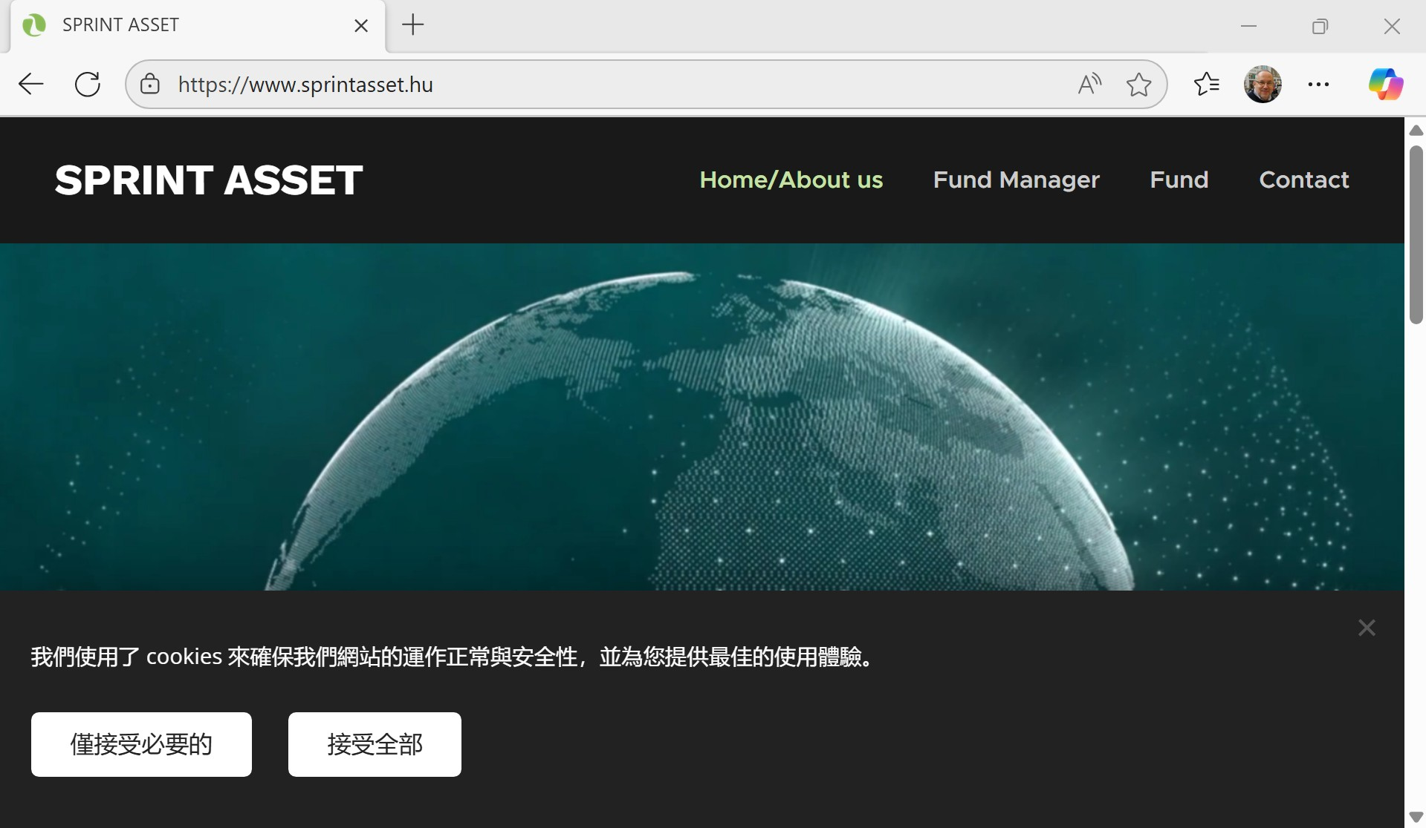
THE WEBPAGE OF SPRINT ASSET

Slide 51

HUNGARY GOLDEN VISA - WEBSITE
„The SPRINT Hungary Real Estate Development and Investment Fund is a closed-end fund managed by SPRINT ASSET Hungária Zrt. Investors pay an annual management fee of 2.5% of net asset value. Upon entry, there is an administrative fee of over €65,000 and a commission of €5,000.” Source: https://hungarygoldenvisa.io/
Note the coat of arms of Hungary and the .io domain!

Slide 52
Unusual elements - list
Speed of adoption, practical lack of social consultation
Lack of substantive economic, social or political justification
Change before entry into force - removal of real estate purchase
Gross difference between investment with return and donation
Only two licenced investment funds.

Slide 53
Unusual elements 1
Speed of adoption of the scheme, practical lack on social consultation
- Less than a month between submission of proposal and final vote in Parliament
Only two committees discuss, in a matter of minutes rather than hours. One opposition member suggested to delete the guest-investor institution – he was voted down.
The government submits 226 amendments to its own bill, many of which change the rules on guest investors and funds
May indicate internal strife
Excludes any external, civil control
No substantive impact assessment
Only 8 calendar days left for public discussion of the bill. The debate in Parliament starts a day before the deadline expires (21 and 22 November)
Bill T/6079 of 14 November 2023 was 175 pages long, contained 392 sections and was accompanied by a 78 p long explanatory note

Slide 54
Unusual elements 2
Lack of substantive economic, social or political justification
The explanatory note simply recalls the normative text without explaining why the institution should be introduced
- The exposé of State Secretary Rétvári refers to the fact that
= 12 EU member States have a similar system.
= guest investorship is introduced „with a view to the interests of the national economy” - /no
identification of that interest was offered-BN/
= thorough national security checks will be applied
------------
No reference to the previous settlement bond regime, no reflection on why rebirth follows coma and what the difference is.

Slide 55
Unusual elements 3
Amendments before entry into force
Several changes introduced by amendments to the law before the operation of the system started mid 2024.
Most important: the option to purchase real estate for the value of at least 500 000 Euros was completely removed
The explanatory note to the amendment refers to „a group of members of the European Parliament” who identified the purchase of real estate used for housing as a risk – therefore the Hungarian Government removes it from the options
(Explanatory note to the bill T/9707 on the resilience of critical infrastructure, by Sándor Pintér, Minister for Interior, 14 December 2024, p. 20) The amendment is codified in § 135 (2) of Act no LXXXIV. of 2024

Slide 56
Unusual elements 4
Gross difference between investment with return and donation
Why ask four times more to be donated than what has to be invested? (1 million versus 250 000)?
The only benefit: in case of donation residency permit is automatically renewed after 10 years (if no termination cause emerges)
Possible explanation: Beneficiaries of the donation are close to FIDESZ foundations and the gesture of donation may be appreciated

Slide 57
Unusual elements 5/a
Only two licenced investment funds
Sprint Asset Hungária Zrt, the fund manager was established on 21 March 2024 and was registered by the Hungarian national bank as a security checked enterprise on 15 August 2024.
The auditor’s report noted that its own capital sank below the legal minimum
The fund manager did not seem to possess the residential properties at the end of 2024
(All info based on Hungarian documents published by the company at https://www.sprintasset.hu/documents/policies/ (20251126) )
--------
Sprint Asset Hungária is owned by Sprint Asset Holding Ltd, which in turn is owned and run by the same person, who was one of the final beneficiaries of the company selling the settlement bonds in China, called Hungarian State Special Debt Fund (HSSDF)
Source: Telex article by Gergely Brückner https://bit.ly/4infhHO (20251126) and official company registers

Slide 58
Unusual elements 5/b
Gravitas Hungary Real Estate Fund, managed by Gránit Alapkezelő (Gránit Fund manager)
Gránit is a well-established innovative bank, whose fund manager entity manages several funds, including 28 real estate funds with a total value of 400 billion HUF (approx 1 Billion euros) https://www.portfolio.hu/ingatlan/20250123/a-granit-alapkezelo-is-reszt-vesz-a-vendegbefektetoi-programban-736559 and https://granitalapkezelo.hu/befektetesi-alapok/ (20251126)
The Gránit Alapkezelő got its security clearance in January 2025
Through a chain of companies the son in law of the Prime Minister has decisive influence on Gránit Alapkezelő
________________

Slide 59
BROADER CONTEXT – HUNGARY AS THE MOST CORRUPT EU COUNTRY
„Systemic corruption plays a pivotal role in the maintenance and consolidation of the regime as the former is applied as a mode of societal (re)allocation of wealth and opportunities …, whereby large fractions of public and EU funds are funneled to clientele networks overseen and controlled by the inner circles of Orbán … .Systemic corruption evolved iteratively with state capture and resulted in the emergence of patronal (or “mafia”) state …
Hungary is the most corrupt country among East and Central European (as well as among all EU) MSs, as measured by the Varieties of Democracy Institute (V-Dem) Political corruption index … Hungary has also ranked consistently among the most corrupt countries in the EU over the past few years across various other corruption indices, such as Transparency International’s (TI) Corruption Perceptions Index (CPI), and the World Bank’s Control of Corruption Index.” (References ommitted)
Martin – Hajnal, 2025, p. 3
Notes:
Autocratic Patrimonialism
„These states, characterized by a powerful state that faces neither strong formal institutional nor societal constraints, are inclined to implement relatively centralized corruption networks to seize state assets and consolidate their power. Occasionally, they seek to curb certain forms of (typically petty) corruption”
Political Studies Review, 2025, https://journals.sagepub.com/doi/10.1177/14789299251335227 1–21 Varieties of Corruption? A Typology of Country-Level Corruption Patterns Using Fuzzy-Set Ideal Type Analysis Áron Hajnal1 , Attila Bartha1,2 and József Péter Martin3,4
___________________________
„Systemic corruption—broadly defined as an institutionalized and normalized form of corruption (Cuellar & Stephenson, 2022)—plays an important role in building and solidifying hybrid regimes (i.e., regimes mixing democratic and authoritarian features) and has been a pivotal instrument in autocratization processes within the EU. In Hungary, Viktor Orbáan has widely applied it to strengthen his power since 2010 ….

Slide 60
BROADER CONTEXT: STATE CAPTURE
„Systemic corruption and state capture …evolve iteratively. State capture— defined as the seizure of control over public institutions and legislation by narrow interest groups for the benefit of their own interests rather than the public good … — is perpetuated through staffing state institutions with loyalists and exerting improper influence over the formation of laws and policies---” Originally referred to powerful businessmen (oligarchs), now includes: politicians, political parties, or informal networks of the political elite and oligarchs who capture the state.
„State capture constitutes a crucial precondition for systemic corruption as it provides impunity for high-level perpetrators and enables building and operating entire state systems to funnel public money to favored groups.” (references ommitted)
Martin – Hajnal, 2025, p. 3

Slide 61
CONCLUSION Two possible readings of both CBI and RBI
Positive
Good faith investors
Contribute to local economy
Ensure their own
basic human rights,
their safety, security
and freedom of movement
Critical
Bad faith investors
- Escape duties in home country
may distort the market in the new country
- cover up or commit crimes
- may pose security threat
Personal view:
As the grounds for claiming exclusion from a society are usually morally unjustifiable and the result of historic violence, any myth sustaining the bonds based on birthright lottery is not defensible from a consequent liberal attitude
CBI specific, critical
Commercialization of citizenship undermines
the special relationship of solidarity and good faith between the state and its nationals
and
the reciprocity of rights and duties

Slide 62
Institutional documents
European Commission, 2019 “Investor citizenship and residence schemes in the European Union”, Report from the Commission to the European Parliament, the Council, the European Economic and Social Committee and the Committee of the Regions, Brussels, COM(2019) 12 final,23.1.2019.
European Commission, 2022 “Recommendation on immediate steps in the context of the Russian invasion of Ukraine in relation to investor citizenship schemes and investor residence schemes”, Brussels, C(2022) 2028 final, 28.3.2022
European Court of Justice: C-181/23 Grand Chamber Judgment Commission v Malta (Citoyenneté par investissement) 29/04/2025, ECLI:EU:C:2025:283
European Court of Justice, Advocate General: Opinion, Commission v Malta (Citoyenneté par investissement) 04/10/2024, ECLI:EU:C:2024:849
European Parliament, 2014, „Resolution of 16 January 2014 on EU citizenship for Sale”, P7_TA(2014)0038
European Parliament, 2022, „ Resolution of 9 March 2022 with proposals to the Commission on citizenship and residence by investment schemes” P9_TA(2022)0065; (2022/C 347/08)
For the EP see also „Fernandez” and „Scherrer” in the literature list for the 2018 and 2022 studies
FATF/OECD,’Misuse of Citizenship and Residency by Investment Programmes’ 2023, Paris, FATF, https://doi.org/10.1787/ae7ce5fb-en

Slide 63
Literature hints
Bauböck, Rainer (ed.),’Debating Transformations of National Citizenship’, 2018, IMISCOE - Springer
Chamon, M., ’Commission v Malta (C-181/23) and the Trilemma of EU Citizenship’ European Law Review, 2025, 50(4), 475-486.
Clerides, Sofronis; Coelho, Maria; Klemm, Alexander, and Kotsogiannis,Christos, ‘ Drivers and Effects of Residence and Citizenship by Investment’ IMF, 2025 Working Papers 25/8.
Fernandes, Meenakshi and others, ‘Avenues for EU Action on Citizenship and Residence by Investment Schemes: Study for the European Parliament’ (PE 694.217, October 2021).
Kochenov, Dimitry Vladimirovich: Investor Citizenship and Residence: the EU Commission’s Incompetent Case for Blood and Soil, VerfBlog, 2019/1/23, https://verfassungsblog.de/investor-citizenship-and-residence-the-eu-commissions-incompetent-case-for-blood-and-soil/, DOI: 10.17176/20190211-220929-0
Kochenov, Dimitry and Surak, Kristin (eds), ’Citizenship and Residence Sales Rethinking the Boundaries of Belonging’, Cambridge University Press, 2023
Kochenov, Dimitry and Íñiguez, Guillermo,’EU citizenship's new essentialism, European Law Review, 2025, 50(4), 455-474

Slide 64
Literature hints
Martin, József Péter and Hajnal, Áron, ’Trials and Errors: Limitations of Anti-Corruption and Rule-of-Law Policies in the Context of Systemic Corruption. The Case of Hungary, Public Integrity, (01 Oct 2025): DOI: 10.1080/10999922.2025.2554409
Nagy, Boldizsár,’Investment migration and Corruption: State Capture and the Hungarian residency Bond Program 2012 – 2017. in Kochenov-Surak, 2023, pp 465 - 484
Shachar, Ayelet and Hirschl, Ran, ’On Citizenship, States, and Markets’ Journal of Political Philosophy, 2014/2, 231—257 DOI: 10.1111/jopp.12034
Scherrer, Amandine and Thirion, Elodie,’Citizenship by Investment (CBI) and Residency by Investment (RBI) schemes in the EU. State of play, issues and impacts’ 2018 EP Study, PE 627.128 – October 2018
Surak, Kristin, ’The Golden Passport. Global Mobility for Millionaires’ Harvard, 2023
Surak, Kristin, “Do Passports Pay Off? Assessing the Economic Outcomes of Citizenship by Investment Programs,” , 2024, Journal of Ethnic and Migration Studies, https://www.tandfonline.com/doi/full/10.1080/1369183X.2024.2332825 (20251204)

Slide 65
Děkuji!
Boldizsár Nagy
Central European University
Nagyb at ceu.edu
www.nagyboldizsar.hu

